Slide 1
Which flights tonight
will be badly late?
CHALLENGE #5 · AI & AEROSPACE TRACK
We warn the traffic management coordinator at Atlanta (ATL) and Dallas–Fort Worth (DFW) 3, 6, 9 or 12 hours ahead.
USER
THEIR DAILY QUESTION
ATC traffic management coordinator
“Which flights tonight will be badly late?”
Autonomous SG 2026 · Acacia Hackathon Society × NUS
Notes:
[18 s] Meet the traffic management coordinator at Atlanta or Dallas–Fort Worth. Every afternoon they ask: which flights tonight will be badly late? We give them that warning 3, 6, 9 or 12 hours ahead, so they can plan instead of react.

Slide 2
For every departure and arrival at ATL or DFW:
what’s the chance it’s more than 45 minutes late?
THE QUESTION, SIMPLY
Departures
Arrivals
Cancelled flights
Badly late = departure delay over 45 min
Badly late = arrival delay over 45 min
Not scored
Target defined by the organisers · 2 / 10
Notes:
[10 s] So the question is simple. For every departure and arrival at these two airports, what’s the chance it ends up more than 45 minutes late? That’s the organisers’ definition. Cancelled flights aren’t scored.

Slide 3
Two sources, joined on time and airport
DATA
25,612
10.7%
45,264
flight events at ATL/DFW
badly late overall
hours of airport weather
16,151 departures · 9,461 arrivals
over 45 min late
2 airports × 22,632 h
Flights: organiser file, Jan 2023 – Jul 2025. Weather: hourly at ATL/DFW from Meteostat / NOAA ISD, with wind direction. ATL↔DFW flights count once at each end.
3 / 10
Notes:
[12 s] Two sources. The organisers’ flight file, January 2023 to July 2025, gives us about 25,600 departures and arrivals; 10.7% were badly late. We join it to 45,000 hours of airport weather, including wind direction.

Slide 4

How it works, in five steps
METHOD
Events
Weather we could know
LightGBM
Dashboard
Flights
organiser file
each departure and arrival
observed ≥ h + 1 h before
one model for every horizon
risk, reasons, “Consider…” advice
Inputs: temperature, rain, wind, pressure, weather code, headwind / crosswind / tailwind on runway 080° (ATL) and 180° (DFW), storm flags, 1–6 h trends, time of day, airline.
Split by time: train Jan 2023 – Jun 2024 · tune Jul – Dec 2024 · test Jan – Jul 2025, never seen.
No LLM at runtime. Risk = LightGBM · reasons = its feature contributions · recommendations = explicit rules.
4 / 10
Notes:
[22 s] Five steps. Each flight becomes a departure event and an arrival event. We attach only weather we could have known in advance, including wind across and along the runway. One LightGBM model scores the risk. The dashboard shows the score, its reasons and a rule-based suggestion. No LLM at runtime.

Slide 5

We never peek at future weather
NO CHEATING
Weather we use
Warning issued
Flight
observed at least h + 1 hours before the flight
h = 3, 6, 9 or 12 hours before
scheduled time
+1 h buffer: a weather report can be stamped up to 52 min before it was observed.
The flight file’s own weather was 4–6 h off, so it is never used as an input.
An automatic leakage test checks every row.
5 / 10
Notes:
[18 s] The easy way to cheat is to use the weather at flight time. We don’t. We only use weather observed at least h hours before, plus one extra hour, because reports can be stamped up to 52 minutes early. A test checks every row.

Slide 6
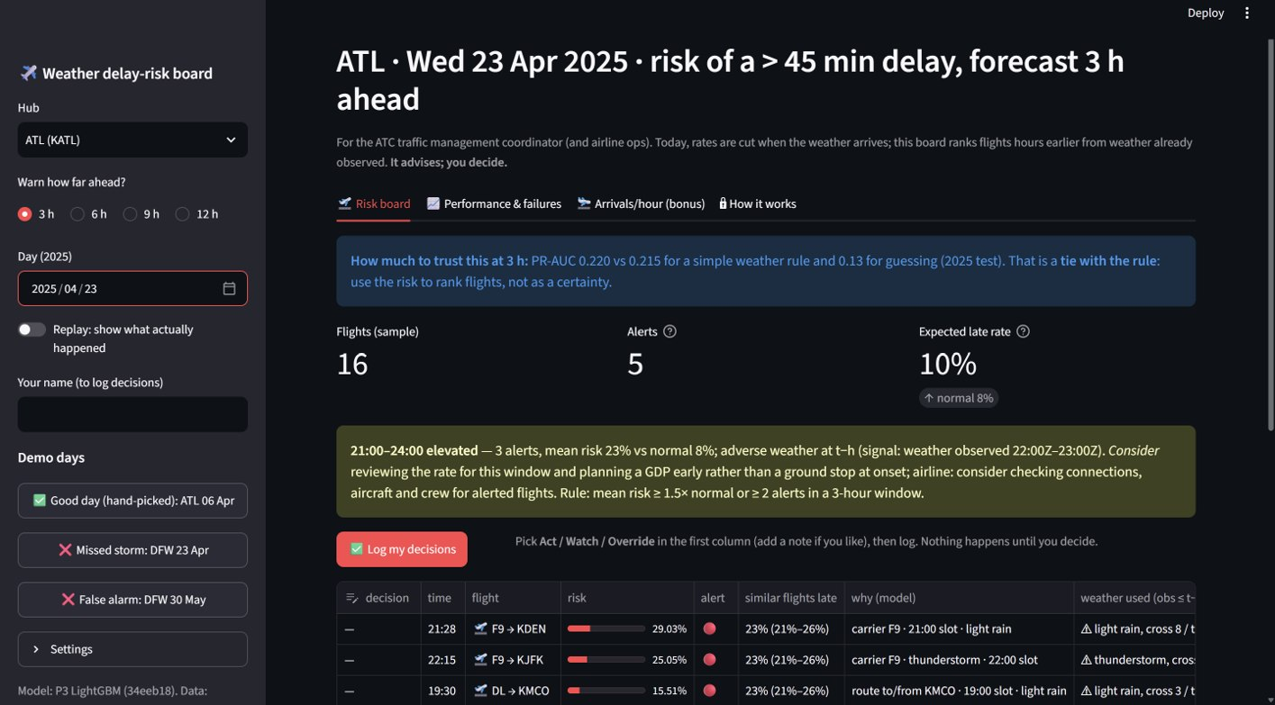
What the coordinator sees
DEMO
Risk board
“Consider…” advice showing the rule, the weather and its timestamp
Flight table
risk, “similar flights were late X%”, and the reasons
Decision log
Act / Watch / Override — the coordinator decides
6 / 10
Notes:
[18 s] Here’s the dashboard. The risk board suggests actions starting with “Consider”, each showing the rule, the weather reading and its timestamp. The flight table explains every score. The decision log keeps the coordinator in charge: act, watch or override.

Slide 7
Ahead of strong operational baselines
RESULTS · 2025 TEST, ~5,700 FLIGHTS, 13.2% BADLY LATE
PR-AUC = how well it ranks the truly late flights first. Higher is better; guessing = 0.13.
Guessing
0.132
History
0.189
History + month
0.198
Weather rule
0.215
Our model
0.220 (95% CI 0.19–0.25)
1.7×
+9% at 12 h
~Half caught
better than guessing (+0.087, CI +0.064 to +0.114)
vs the weather rule; a tie at 3 h. Model holds 0.219–0.222, rule drops to 0.202
49–53% of badly late flights, 3–12 h ahead; about 1 in 5 alerts is right
Trained on ATL only, it still scores 0.194 at DFW (0.233 own model) · Source: outputs/metrics/pitch.md, metrics_ci.csv · 7 / 10
Notes:
[25 s] PR-AUC measures how well we rank late flights first; guessing scores 0.13. Our model scores 0.22, 1.7 times better. It ties the weather rule at 3 hours but holds steady, beating it by 9% at 12 hours. It catches about half of badly late flights.

Slide 8
Weather is a small cause, but a sharp one
INSIGHT
What caused badly-late delay minutes at ATL/DFW (airline cause codes, after the fact)
■ Late-arriving aircraft 43.6%
■ Airline operations 33.0%
■ Air-traffic system 15.0%
■ Weather, coded directly 8.3%
37.7%
Adding weather to the delay model: +0.012 PR-AUC, not significant. Even perfect same-hour weather: +0.003.
of thunderstorm flights badly late, vs 10.6% normally
Arrivals-per-hour model (full public BTS data): 1–7% better than a strong schedule baseline overall, 4–13% better in bad-weather hours (significant at every horizon).
only 61 storm flights in the sample
8 / 10
Notes:
[20 s] Here’s the insight. Weather directly causes only 8% of severe-delay minutes; late aircraft and airline operations cause most. But when it storms, the badly-late rate jumps from 11% to 38%. And our arrivals model is 4–13% better in bad-weather hours.

Slide 9
Where it fails, and how you’d know
FAILURE CASE
DFW · 23 APR 2025 · MISSED
9 of 11
How the coordinator notices
Trust line on the dashboard: “ties the weather rule at 3 h”
Calibration chart
The “similar flights were late X%” range
These failure days are shown in the app
flights badly late. The model expected about 2.
Why: overcast 3 h before; the storm formed later; most delay was late aircraft.
False alarm, DFW 30 May 2025: a north wind was counted as a tailwind on runway 180°.
Source: outputs/metrics/pitch.md, failure_cases.md · 9 / 10
Notes:
[18 s] Where does it fail? DFW, 23 April 2025: nine of eleven flights badly late, we expected two. Three hours before, it was just overcast; the storm came later. The dashboard shows its limits openly, so the coordinator knows when not to trust it.

Slide 10
Limits, next steps, and the payoff
HONEST LIMITS
Limits
Next steps
Impact (measured on 2025)
Most misses are calm-weather delays (late aircraft, airline ops)
2025 had more delays (13.2% vs ~10%), so risks read low
Weather only at ATL/DFW; flight file is a ~0.5% sample; no gust or snow data
Demo days hand-picked; airports, runways and thresholds come from config
Airport-congestion features from full BTS data (+0.04 PR-AUC at 3 h in an earlier version)
Weather forecasts, not just observations
Origin-airport weather
Wider arrival ranges in severe weather
~Half
of badly late flights flagged 3–12 h ahead, so the coordinator can plan instead of react
1.7× better ranking than guessing; +9% vs the weather rule at 12 h. No cost savings claimed.
10 / 10
Notes:
[18 s] Limits: most misses are calm-weather delays, and 2025 was busier than training. Next: congestion features, forecasts and origin weather. The payoff we measured: about half of badly late flights flagged hours ahead, giving the coordinator time to plan. Thank you.

Slide 11
Sources, assumptions and credits
APPENDIX
Sources
Assumptions
AI use & team
Weather: Meteostat (meteostat.net), CC BY 4.0, data from NOAA ISD (stations 72219 ATL, 72259 DFW)
Flights: organiser file, Jan 2023 – Jul 2025
Full flights for the arrivals model: US DOT BTS On-Time Performance (licence not verified)
Results: outputs/metrics/pitch.md, metrics_ci.csv, failure_cases.md
Runway headings 080° ATL, 180° DFW (organiser)
1 h buffer on weather timestamps
Cancelled flights not scored
Rates = badly late events ÷ scored events
Alert thresholds set on validation only (ATL 0.098, DFW 0.123)
No LLM at runtime: risk = LightGBM, recommendations = explicit rules, reasons = LightGBM feature contributions
Built with AI coding help (Claude Code); explanatory text AI-drafted and reviewed by the team
P1 data & features · P2 arrivals model · P3 delay model · P4 evaluation & dashboard
Appendix · not presented
Notes:
Appendix, not presented. Use for judge questions about data sources, licences, assumptions and AI use.

